Slide 1
How to log into your Chromebook

Slide 2
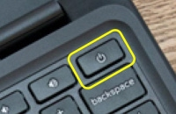
Open your Chromebook lid and press the power button.

Slide 3
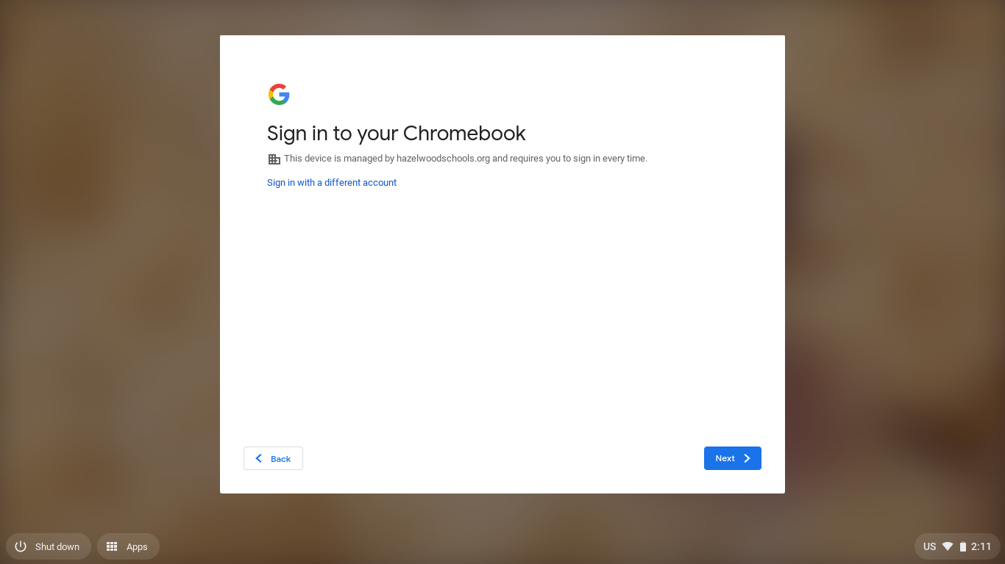
Select Next

Slide 4
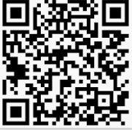
Select the Login With Password box to log in with your username and password
Or
If you were given a QR code select the Login With Lanyard box

Slide 5
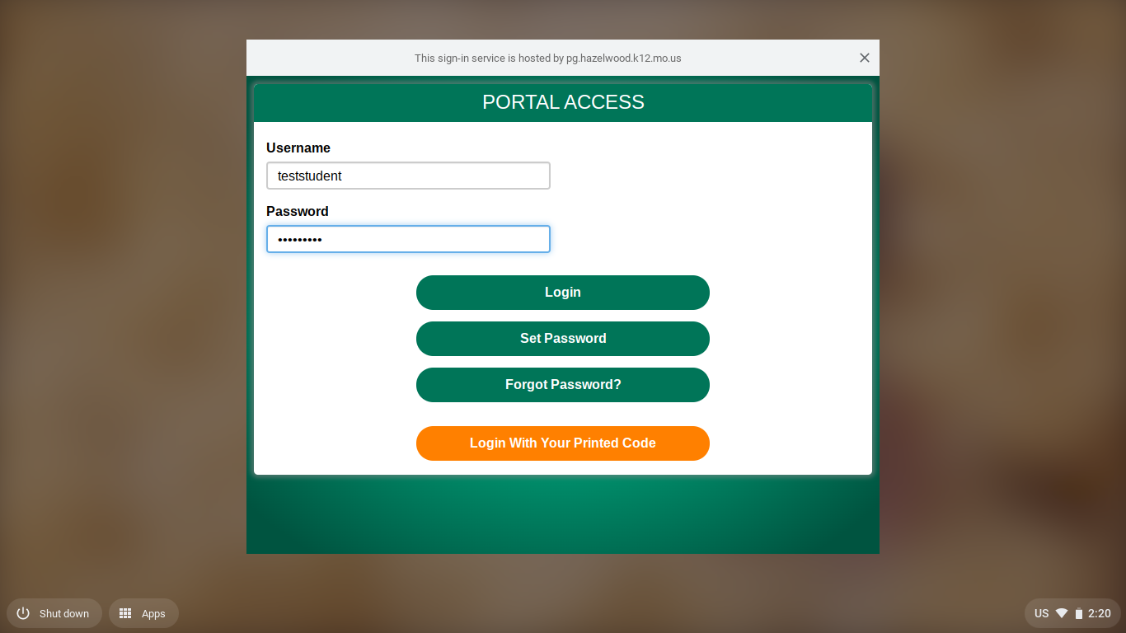
To log in with your Password
Type your student ID in the Username field.
Type your password in the Password field.
The default password for students is HSDmmddyy (birthday)

Slide 6
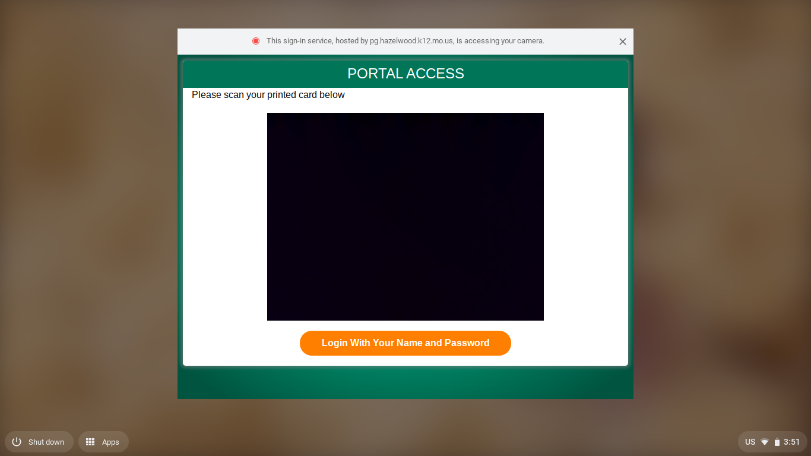
To log in with your QR code
Hold your QR code in front of the camera located above the screen of your Chromebook.
camera

